Slide 1


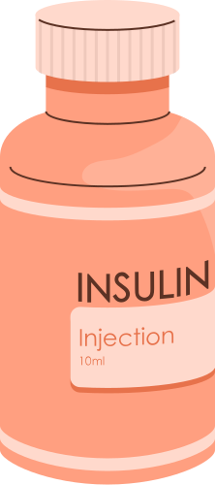
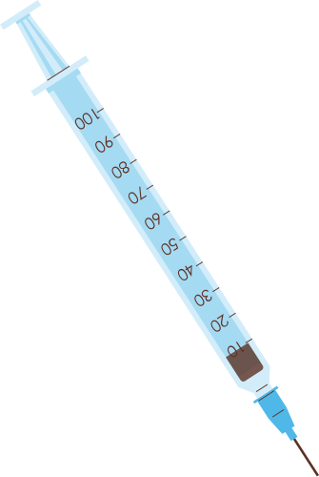

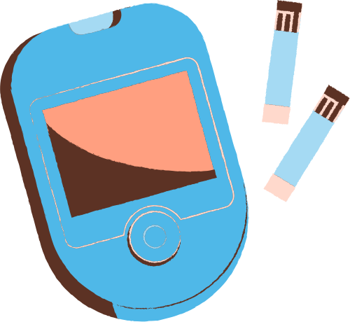

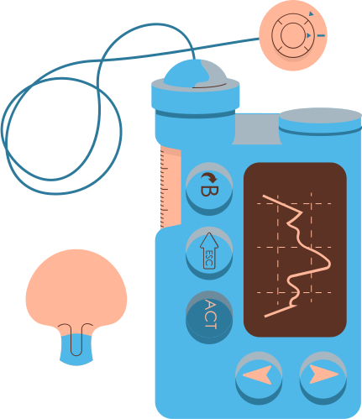
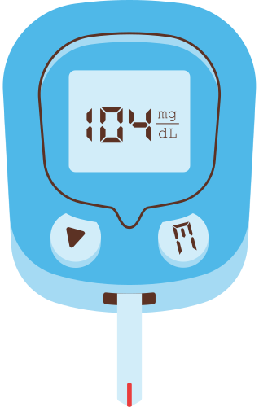

DIABETES PREDICTION USING MACHINE LEARNING
Name: Unison Raj Tuladhar (C15)
London Met Id: 23050414
Module: CU6051NI/ Artificial Intelligence(AI)

Slide 2

AGENDA
  Topic Overview
  AI Concepts Used
  Research Evidences
  Reason for Selection of the Topic
  Proposed Solution
  How the Application Works
  Pseudocode
  Flowchart
  Real-world Problems Solved
  Achieved Results
  Conclusion

Slide 3

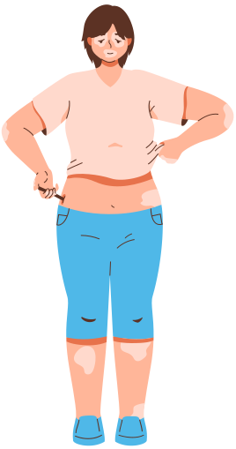
TOPIC OVERVIEW
•This project focuses on predicting diabetes using supervised machine learning.
•Healthcare dataset with medical attributes is being used.
•The system predicts whether an individual is Diabetic or Non-Diabetic.

Slide 4

AI CONCEPTS USED
• Artificial Intelligence
• Machine Learning
• Supervised Learning: Classification
• Algorithms Used : Logistic Regression, Random Forest, Support Vector Machine(SVM)

Slide 5

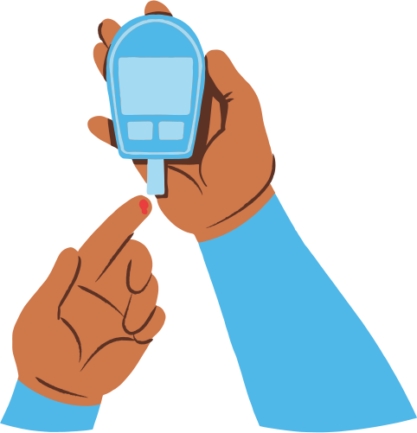
RESEARCH EVIDENCES
• Previous studies confirm ML improves diabetes prediction accuracy.
• Tree-based and linear models perform well on medical data.
• Research supports early diagnosis using classification models.

Slide 6


REASON FOR SELECTION OF THE TOPIC
• Diabetes is a rapidly increasing global health issue.
• Many people are unaware of diabetes until later stages.
• Early prediction can save lives.
• Machine learning enables early and accurate prediction.
• Highly relevant real-world application.
• Dataset availability for the supervised learning.

Slide 7

PROPOSED SOLUTION
• Use supervised ML models for diabetes classification.
• Preprocess medical dataset and handle missing values.
• Train and evaluate multiple algorithms.
• Select best-performing model based on accuracy.

Slide 8
HOW THE APPLICATION WORKS
• Load diabetes dataset.
• Preprocess data.
• Split dataset into training and testing sets.
• Train ML models.
• Predict diabetes status.
• Evaluate performance using accuracy and metrics.

Slide 9
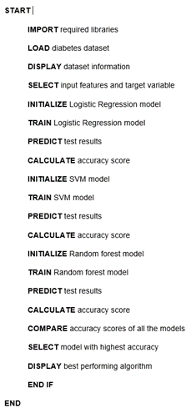
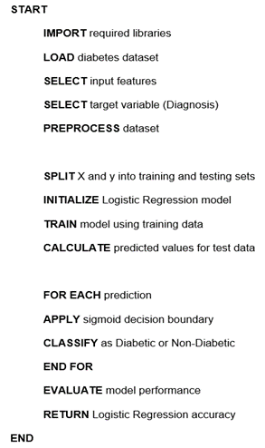
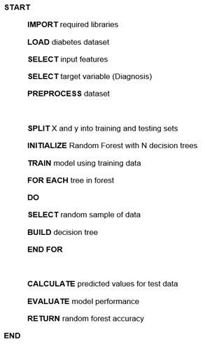
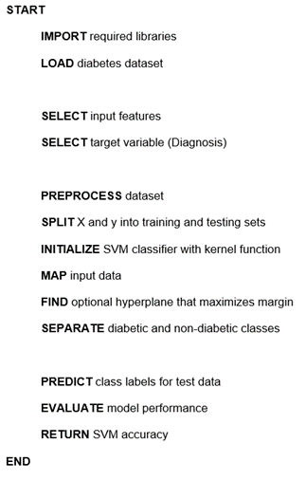
PSEUDOCODE
OVERALL SYSTEM
LOGISTIC REGRESSION
SUPPORT VECTOR MACHINE
RANDOM FOREST

Slide 10
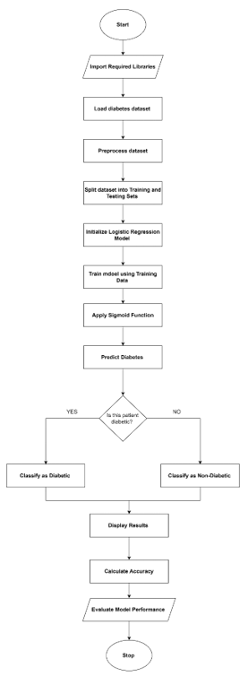
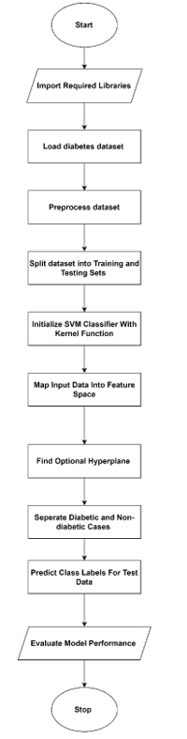
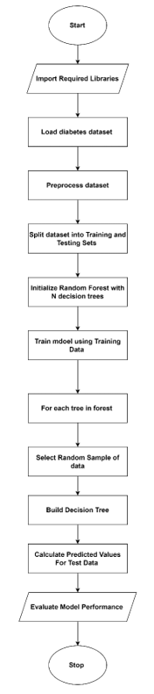
FLOWCHART
LOGISTIC REGRESSION
SUPPORT VECTOR MACHINE
RANDOM FOREST

Slide 11

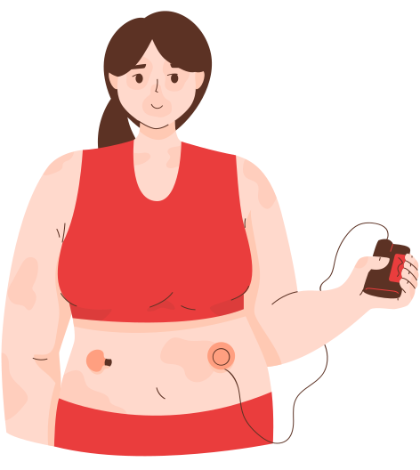
Real-world Problems Solved
• Early detection of diabetes.
• Supports healthcare decision-making.
• Reduces late-stage diabetes complications.
• Assists doctors and health professionals.

Slide 12
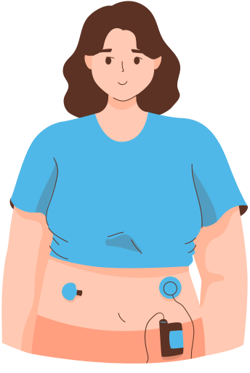
ACHIEVED RESULTS
• All three models were successfully trained and evaluated.
• System accurately predicts diabetic and non-diabetic patients.
• Random Forest achieved the highest accuracy.
• Overfitting was resolved using regularization.

Slide 13
CONCLUSION
• ML-based diabetes prediction system was successfully implemented.
• Random Forest performed best among all models.
• System demonstrates strong healthcare applicability.
• Future work can include larger datasets and deep learning.

